Slide 1
Online Student Services Raising the Bar Bonnie Peters Chief Student Services Officer (CSSO) Online Education Initiative

Slide 2
ONLINE EDUCATION INITIATIVE
OEI
The California Community College Online Education Initiative (OEI), is a project, state funded through the California Community College Chancellor’s Office (CCCCO). The Online Education Initiative represents a comprehensive and collaborative program that leverages best practices and technology to significantly increase the opportunity for higher education degree attainment in California.
www.ccconlineed.org

Slide 3
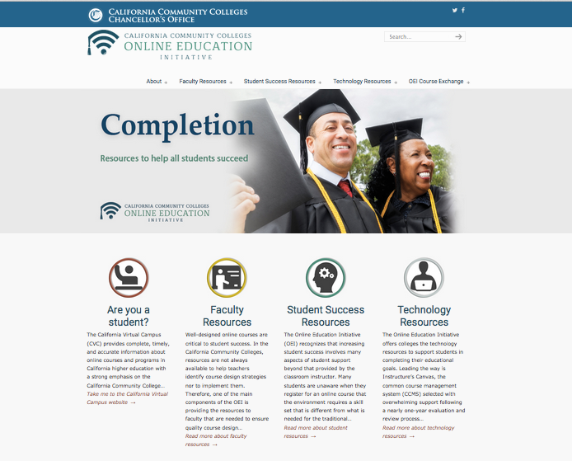
ONLINE EDUCATION INITIATIVE (OEI)
GOAL
To increase student COMPLETION of courses, degrees and transfer requirements, by providing access to quality online courses and online support services.

Slide 4
OUR FOCUS
Common Course Management System -Canvas
Development of online student Support Services
Develop CCC Course Exchange
Collaborate with CCC faculty to develop quality online courses

Slide 5
WHAT OEI OFFERS STUDENT SERVICES
An opportunity to seamlessly incorporate Student Services into a college’s Distance Education, thereby meeting accreditation standards and enhancing distance education programs by supporting students online.
Notes:
Discuss the lack of development with regards to online student services. Online education has developed on the instructional side of the house, but the same has not happened with regards to online support service online counseling it a main area that has been approached in a piecemeal fashion

Slide 6
ONLINE STUDENT SERVICES
What do YOU currently offer?

Slide 7
ACCESS SERVICES ONLINE
Application
Assessment
Orientation
Financial Aid
Registration
eTranscripts
Other?

Slide 8
SUCCESS SERVICES ONLINE
Tutoring?
Library Services?
Counseling?
Early Alert?
Online Bookstore?
Online DSPS processes?
Other?

Slide 9
OEI ONLINE STUDENT SERVICES
Online Student Readiness
Online Counseling
Online Tutoring
Accessibility Standards
Online Student Equity Resources
Online Student Peer Community
Online Library Services

Slide 10
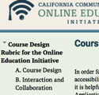
Challenging Resources to Digitize
Online Student Readiness
Online Counseling Services
Online Student Equity Success Strategies
Online Peer Communities

Slide 11
ONLINE READINESS
Quest for Online Success Workshop: Each college has access to a comprehensive readiness program built in a Canvas site for students taking online courses
Quest Multimedia Tutorials: 11 multimedia tutorials, with a Creative Commons license that can be used by everyone. http://apps.3cmediasolutions.org/oei/

Slide 12
QUEST PROGRAM
Novice Online Learners
Smarter Measure Overview Of Online Learning Tech Ready Becoming an Effective Online Learner
Organizational & Study Skills
Time Management
Communication Skills
Online Reading Strategies
Experienced Online Learners
Education Planning
Career Planning
Instructional Support
Personal Support
Financial Planning

Slide 13
ONLINE EQUITY GOALS
Decrease success rate gaps in online courses
Identify strategies to address inequities
Notes:
Arnita
Broad-based Work Group (faculty, counselors, administrators, researchers, instructional designer)
Meets biweekly via Zoom
Focused on creating an equity framework to address achievement gaps, provide institutions with support to assist them with meeting the goals outlined in their student equity plans

Slide 14
ONLINE STUDENT EQUITY
Research
Increase equity by making services available online
Work with colleges to include online students in Equity plans
Create an online mechanism for students to provide self reported data when withdrawing from online courses
Fully resourced vs. o
Notes:
Arnita
Examining equity and diversity issues, beyond basic skills and ADA issues that may impact student success.
Collecting data to determine what’s being done in the field – what’s out there…what can we build on?
Reviewing college equity plans – is Distance Education / Online Students included in Success Indicators? Can the success indicators be broadened to include online students?
If so, what policies, programs, strategies, and activities are being implemented to address the gap?
How are these efforts measured?
What “on the ground” efforts can be extended to the online community? High-impact practices? Professional Learning?
Shift the focus: Comparing fully-resourced online courses to non-resourced instead of face-2-face to online courses.
Professional Learning – supporting faculty, staff and administrators efforts to create equity-based online campuses - embedding equity-minded principles and practices into all aspects of online education – instruction, student services, course design

Slide 15
ONLINE COUNSELING NETWORK
OCN GOALS
Provide equitable access to counseling services for online students
Provide online counseling services parallel to on campus services

Slide 16
OCN COMPONENTS
Structure & Design
Establish a structured and systematic approach to online college counseling
Professional Development and Standards
• Develop, deliver and standardize professional development training and materials aligned to the National Board of Certified Counselors standards for distance counseling professionals
Educational Technology Platform
Partnership with Cranium Café online meeting & collaboration platform

Slide 17
CRANIUM CAFÉ TECHNOLOGY
Integrates with Canvas
Student ID integration
Single Sign-On with CAS and Shibboleth
Outlook integration with push/pull
Google calendar integration with push/pull
Web page integration
LMS / LTI integration
Social Open Auth Guest access & registration
Can function as a stand alone platform
REST API
Notes:
Synchronous online career, personal and educational counseling appointments

Slide 18
WHY CRANIUM CAFE
Designed specifically for Student Services
Online career counseling appointments
Online academic advising appointments
Online drop-in / walk-in counseling sessions
Interactive student success workshops for online students
Online Mental Health appointments
FERPA & ADA Accessibility Compliant
ALL on campus counseling services can be provided via this platform
Zero cost to participating OEI colleges
Demo

Slide 19
PLATFORM TRAINING
Understanding Communication Tools
Technical training with online counseling platform
Understanding and managing the meeting room
Understanding how this platform differs from previous platforms

Slide 20
PLATFORM TRAINING
Who: Online counselors and Administrative staff
What:
OC- Platform Technical Training
AS- Platform Admin Training
When:
August -Fall Administrative Training (Tracy Gorham)
September-October Technical Platform Training (Jessica Hurtado)
Where: Cranium Café Platform (Cranium Café Card)
Why:
Counselors: learn how to navigate the platform (log-in, upload documents, important tools and features.
Administrators: learn how to manage calendars, CC Cards, Scheduling.
Notes:
Jessica

Slide 21
ONLINE COUNSELING COURSE CONTENT
Module 0: Getting started
Module 1: Introduction to online counseling services
Module 2: Comprehensive approaches to counseling online at a community college
Module 3: Supporting online student success and retention
Module 4: Counseling students with disabilities
Module 5: Evaluation of online counseling services
Module 6: Online mental health counseling

Slide 22
THE FUTURE The 1- Stop Online Student Support Center
Online Readiness (Quest Program)
Online Peer Support
Early Alert
Recommended Library Services
Online Counseling Network & Platform
Online Test Proctoring
Embedded Support for Underperforming Students
Accessibility Support & Universal Design
Online Tutoring 24x7

Slide 23
THE FUTURE The 1- Stop Online Student Support Center
Online Readiness (Quest Program)
Online Peer Support
Professional Development & Course Design Rubric
Recommended Library Services
Online Counseling Network & Platform
Online Test Proctoring
Common Course Management System
Embedded Support for Underperforming Students
Accessibility Support & Universal Design
Online Tutoring 24x7

Slide 24
WHAT’S ON THE HORIZON?
Meeting students where they are
Taking more proactive role in the future Distance Education
Partner with instruction to make Distance Ed. Programs “whole.”
Development of Online Student Services Centers

Slide 25
THE CHICKEN OR THE EGG
Who will drive future innovation for online student services?

Slide 26
WHAT’S NEEDED?

Slide 27
CONTACT
Bonnie Peters
Chief Student Services Officer (CSSO)
Online Education Initiative
bpeters@ccconlineed.org
petersbonnie@fhda.edu
Ph: 619 204 7684
Dr. Marilyn Harvey
OEI Professional Consultant
mharvey@ccconlineed.org
Jessica Hurtado
OEI Online Services & Outreach Coordinator
jhurtado@ccconlineed.org

